Slide 1
Cloud Standards Overview
Cloud-Standards.org

Slide 2
Open Standards
Open Standard: A standard developed with a process open to all interested parties and where implementations are free to use the standard.

Slide 3
Some Possible Standards
Federated security (e.g. identity) across Clouds
Metadata and data exchanges among Clouds
Standards for moving applications between Cloud platforms
Standards for describing resource/performance capabilities and requirements
Standardized outputs for monitoring, auditing, billing, reports and notification for Cloud applications and services
Common representations (abstract, APIs, protocols) for interfacing to Cloud resources
Cloud-independent representation for policies and governance
Portable tools for developing, deploying, and managing Cloud applications and services
Orchestration and middleware tools for creating composite applications across Clouds

Slide 4
Standards Groups
In Internet circles, everything eventually gets driven by a working group of one sort or another.
A working group is an assembled, cooperative collaboration of researchers working on new research activities that would be difficult for any one member to develop alone.
exist for anywhere between a few months and many years.
strive to create an informational document a standard, or find some resolution for problems related to a system or network.
attempts to assemble experts on a topic.
Task groups or technical advisory groups.

Slide 5
Standards and Test Bed Groups
Cloud Security Alliance (CSA)
Distributed Management Task Force (DMTF)
Storage Networking Industry Association (SNIA)
Open Grid Forum (OGF)
Open Cloud Consortium (OCC)
Organization for the Advancement of Structured Information Standards (OASIS)
TM Forum
Internet Engineering Task Force (IETF)
International Telecommunications Union (ITU)
European Telecommunications Standards Institute (ETSI)
Object Management Group (OMG)

Slide 6
Cloud Security Alliance (CSA)
Mission Statement
To promote the use of best practices for providing security assurance within Cloud Computing, and provide education on the uses of Cloud Computing to help secure all other forms of computing.

Slide 7
Which Organizations doing What?
 | SaaS | PaaS | IaaS | DaaS
Provisioning |  |  | OGF/DMTF | SNIA
Metering and Billing |  |  |  | SNIA
Security |  |  | OGF/DMTF/CSA | SNIA (IETF)
Privacy
Quality of Service |  |  | DMTF | SNIA
Identity |  | OASIS
Standardization of Cloud Management

Slide 8
Which Organizations doing What?
 | SaaS | PaaS | IaaS | DaaS
Client Application Interface
Development Platform
Virtual Machine Interface |  |  | DMTF
Data Storage Interface |  |  |  | SNIA
Standardization of Functional Interfaces

Slide 9
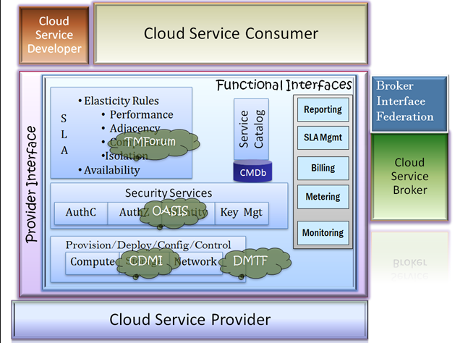

Slide 10
Existing Specifications
SNIA Cloud Data Management Interface (CDMI) http://www.snia.org/cloud
DMTF Open Virtualization Format (OVF) http://www.dmtf.org/standards/published_documents/DSP0243_1.0.0.pdf
OGF Open Cloud Computing Interface (OCCI) http://www.ogf.org/Public_Comment_Docs/Documents/2010-01/occi-core.pdf

Slide 11
Testbeds
Open Cloud Consortium Testbed http://opencloudconsortium.org/testbed/
Open Cirrus Testbed https://opencirrus.org/

Slide 12
Recommendations
Develop and document a process for Open Standards to become US Government recommendations
Working with Cloud standards groups and providers, develop a plan for creating demos, test-beds, and reference implementations
Collect and prioritize government use cases
Document standards requirements and specifications
Review existing standards activities and identify the need for future standards and innovative capabilities
Validate compatibility of uses cases, specifications, standards, and innovative capabilities
Verify that standards and innovative capabilities satisfy specifications and can be deployed by government projects

Slide 13
Possible Testbeds and Demos Areas
Federated Security across Clouds
Federated Cloud Storage
Data Interoperability across Clouds
Portability of applications and tools across IaaS Clouds
Standards for Cloud Monitoring and Management
Standards for Cloud Development and Deployment
Follow-on meetings among government, industry, and standards groups after May 20 could be used to plan these activities

Slide 14
Individual Standards Groups

Slide 15
Open Cloud Consortium
The Open Cloud Consortium (OCC) http://www.opencloudconsortium.org/
  Supports the development of standards for cloud computing and frameworks for interoperating between clouds
  supports the development of benchmarks for cloud computing
  Supports reference implementations for cloud computing, preferably open source reference implementations
  it manages testing platform and a test-bed for cloud computing called the Open Cloud Test-bed.
  workshops and other events.
  Organized into several different working groups.

Slide 16
Groups
Standards and Interoperability for Clouds - On-Demand Computing Capacity
Hadoop architecture
  storage cloud - a distributed file system
  compute cloud - MapReduce
  data cloud - table services.
  support the concept of on-demand computing capacity.
Group on Wide Area Clouds and the Impact of Network Protocols on Clouds – developing technology for wide area clouds, including creation of methodologies and benchmarks to be used for evaluating wide area clouds.
  it is tasked to study the applicability of variants of TCP and the use of other network protocols for clouds.

Slide 17
Groups
Open Cloud Test-bed uses Cisco C-Wave and the UIC Teraflow Network for its network connections.
C-Wave makes free network resources available to researchers to conduct networking and applications research.
Allows to access 10G Waves (Layer-1 p2p) on a per-project allocation.
It provides links to a 10GE (gigabit Ethernet) switched network backbone.
The Teraflow Test-bed (TFT) is an international application network for exploring, integrating, analyzing, and detecting changes in massive and distributed data over wide-area high performance networks.
It analyzes streaming data with the goal of developing innovative technology for data streams at very high speeds.

Slide 18
Groups
Hope - prototype technology can be deployed over the next decade to analyze 100-gigabit-per-second (Gbps) and 1,000-Gbps streams.
wavelengths provided by the National Lambda Rail (NLR).
it support many distinct networks for the U.S. researchers using the same core infrastructure.
Production and Experimental networks exist side by side but are physically and operationally separate.
Production networks support cutting-edge applications by providing users guaranteed levels of reliability, availability, and performance.
experimental networks enable the deployment and testing of new networking technologies, providing researchers national-scale testbeds

Slide 19
Groups
Group on Information Sharing, Security, and Clouds - standards and standards-based architectures for sharing information between clouds.
  security architectures for clouds.
Open Cloud Test-bed Working Group - manages and operates the Open Cloud Test-bed.
  membership in this working group is limited to those who contribute computing, networking, or other resources to the Open Cloud Test-bed.

Slide 20
Distributed Management Task Force
“DMTF’s Open Cloud Standards Incubator focuses on standardizing interactions between cloud environments by developing cloud resource management protocols, packaging formats and security mechanisms to facilitate interoperability.”
enables more effective management of millions of IT systems worldwide by bringing the IT industry together to collaborate on the development, validation and promotion of systems management standards.
160 member companies and organizations, and more than 4,000 active participants crossing 43 countries.

Slide 21
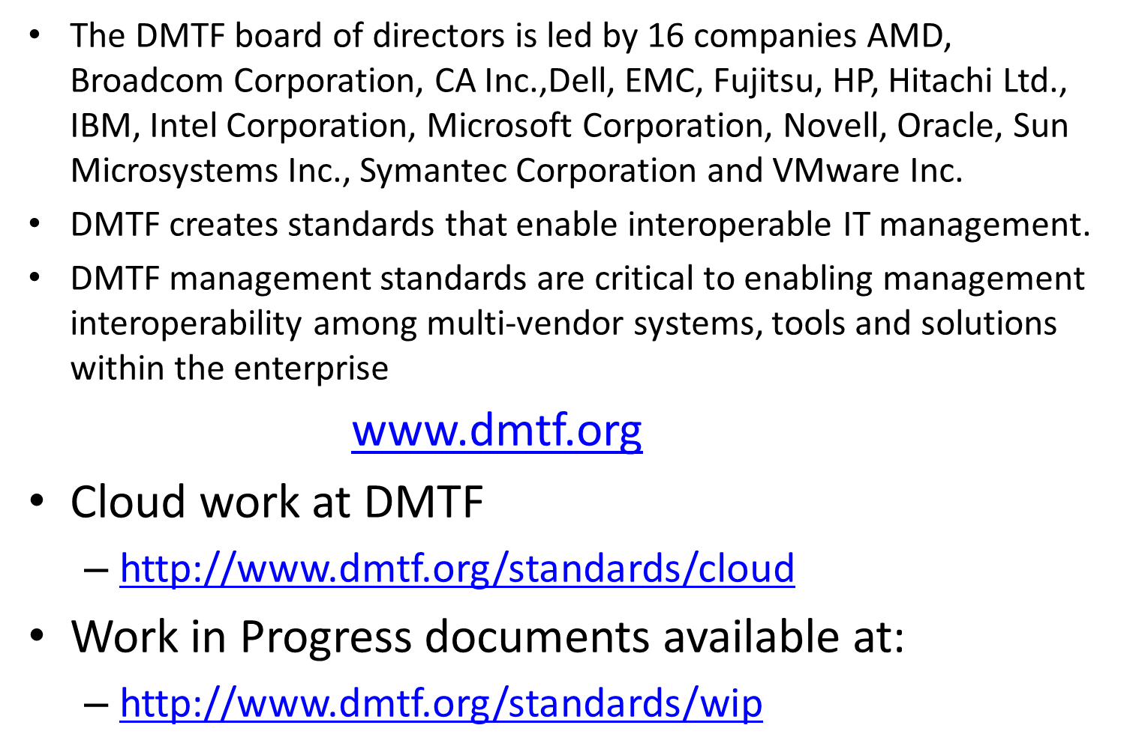
Contd…

Slide 22
Contd…
Virtualization Management Initiative (VMAN).
delivers broadly supported interoperability and portability standards to virtual computing environments. VMAN enables IT managers to deploy preinstalled, preconfigured solutions across heterogeneous computing networks and to manage those applications through their entire life cycle.
provides management capabilities to enable IT managers to manage their virtual environments in the context of the underlying hardware.

Slide 23
Open Virtualization Format
OVF Specification from DMTF describes an open, secure, portable, efficient and extensible format for the packaging and distribution of software in (collections of) virtual machines
Optimized for distribution
Optimized for a simple, automated user experience
It is a packaging standard not a runtime standard.
Supports both single VM and multiple-VM configurations
Portable VM packaging
Vendor and platform independent
Extensible
Localizable
Open standard

Slide 24
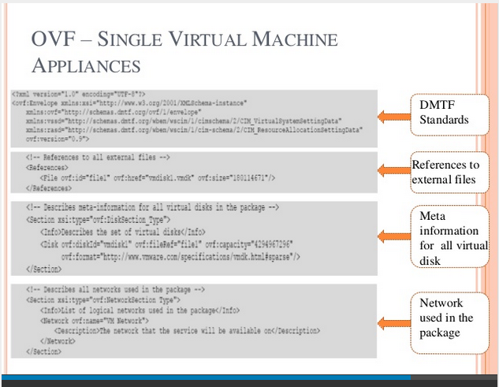

Slide 25
Open Virtualization Format
Standard that has emerged within the VMAN Initiative.
The OVF simplifies interoperability, security, and virtual machine life-cycle management by describing an open, secure, portable, efficient, and extensible format for the packaging and distribution of one or more virtual appliances.
The OVF specifies procedures and technologies to permit integrity checking of the virtual machines (VM) to ensure that they have not been modified since the package was produced.
This enhances security of the format

Slide 26
Contd..
provides mechanisms that support license checking for the enclosed VMs, addressing a key concern of both independent software vendors and customers.
Finally, the OVF allows an installed VM to acquire information about its host virtualization platform and runtime environment, which allows the VM to localize the applications it contains and optimize its performance for the particular virtualization environment.
Provides virtual machine packaging portability.
It is by design, virtualization platform-neutral, it provides the benefit of enabling platform-specific enhancements to be captured.
It also supports many open virtual hard disk formats.

Slide 27
Contd..
Virtual machine properties are captured concisely using OVF metadata. OVF is optimized for secure distribution. It supports content verification and integrity checking based on industry-standard public key infrastructure and provides a basic scheme for management of software licensing.
simplified installation and deployment process.
The OVF streamlines the entire installation process using metadata to validate the entire package and automatically determine whether a virtual appliance can be installed.
It also supports both single-VM and multiple- VM configurations and packages containing complex, multitier services consisting of multiple interdependent VMs.
vendor- and platform- independent.
The OVF is designed to be extended as the industry moves forward
with virtual appliance technology.

